Slide 1




Explainable Artificial Intelligence: Overview, Limitations and Way Forward
Chirag Agarwal

Slide 2
The Road Ahead
Explainability is an evolving field; Research is in progress
Improving the Reliability of Explanations
Developing Evaluation Frameworks for Explanations
Moving beyond Post hoc Explanation Methods

Slide 3
Understanding Data Hardness

Slide 4
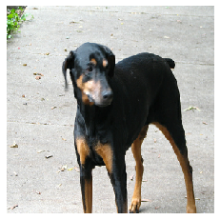
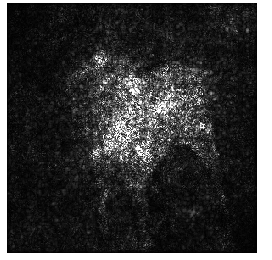
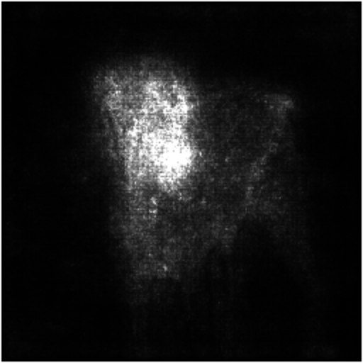
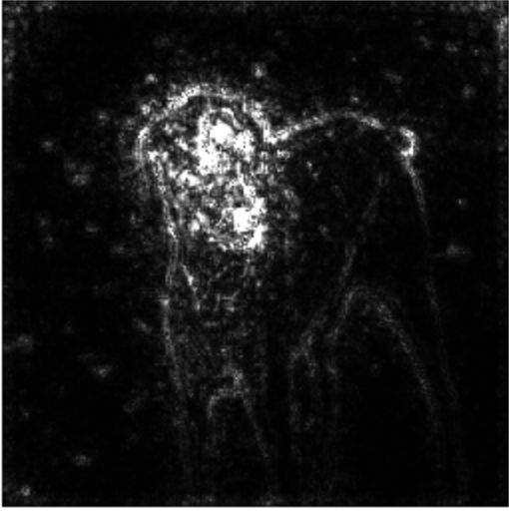
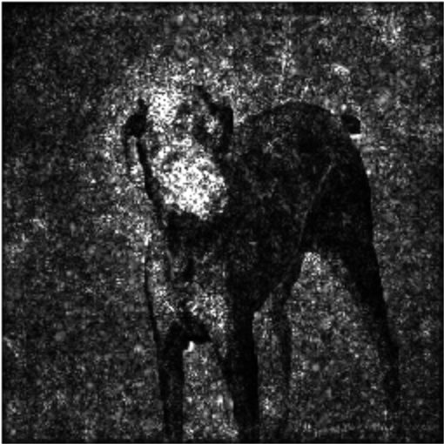

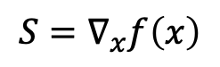
Gradient Based Methods in XAI
Gradient
SmoothGrad
GuidedBackprop
IntegratedGrad
Noisy & Unintuitive!

Slide 5


Hypothesis
“Gradients of easier examples converge early in training whereas gradients from challenging examples continue to vary throughout training”
channel-averaged gradients
32 x 32 x 3
32 x 32

Slide 6
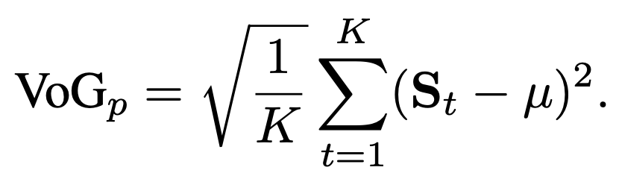
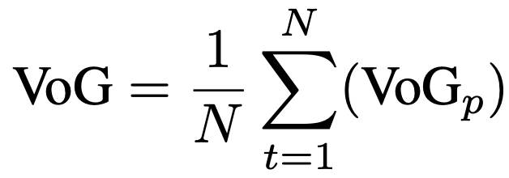
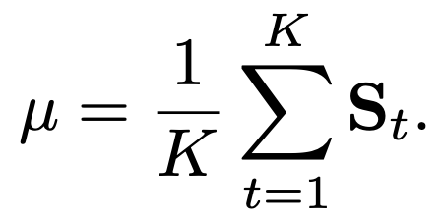


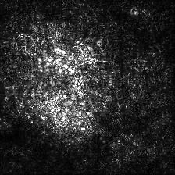
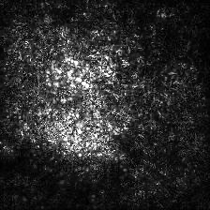
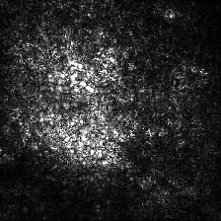
Variance of Gradients(VoG)
Capture channel-averaged gradients over K checkpoints to calculate pixel-wise VoG
Average
where,
0 epochs
90 epochs
Agarwal et al. 2022

Slide 7
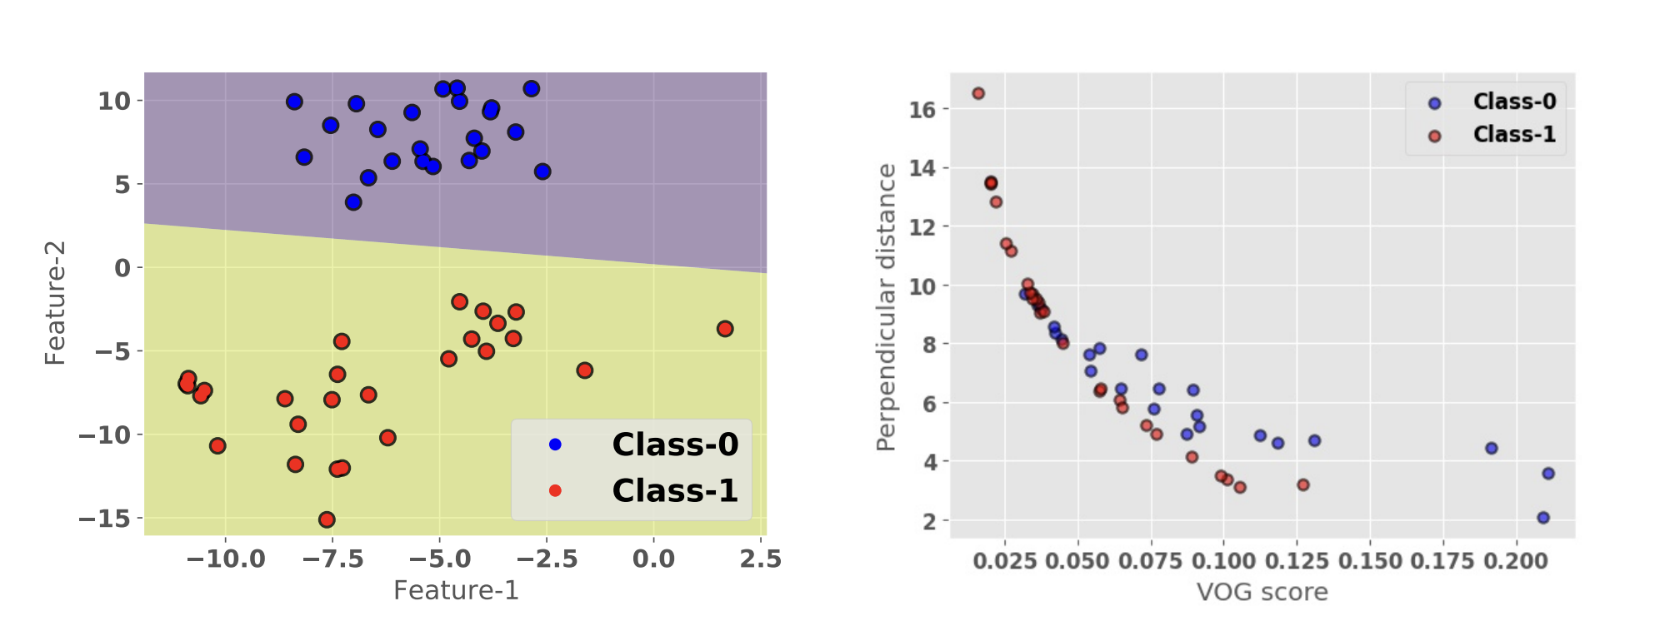
VoG: Toy Experiment

Slide 8
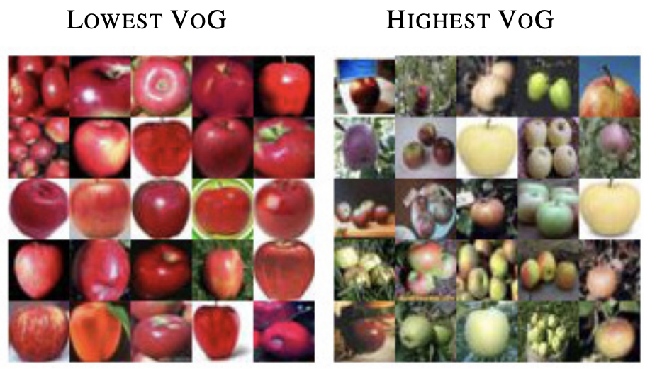
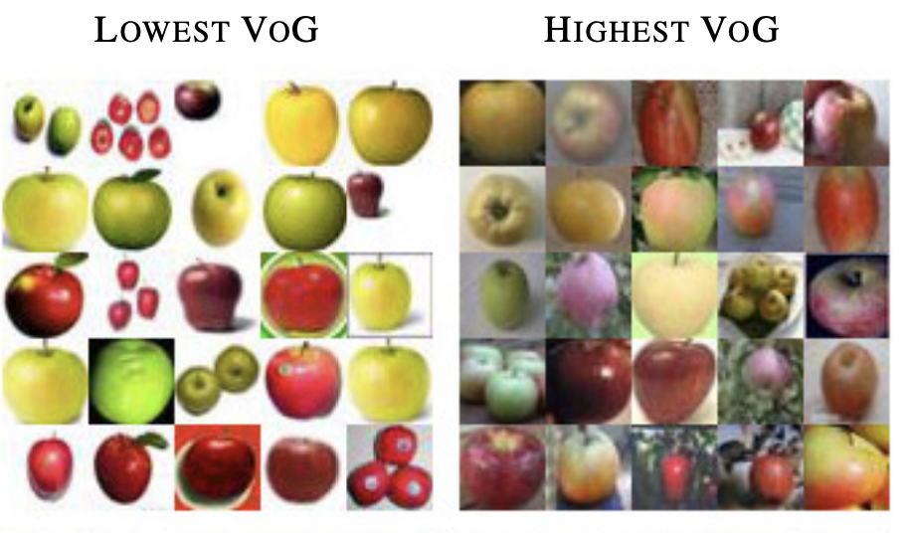
Task 1: Exploring Feature Importance
0 epochs
90 epochs
Early Stage Training
Late Stage Training

Slide 9
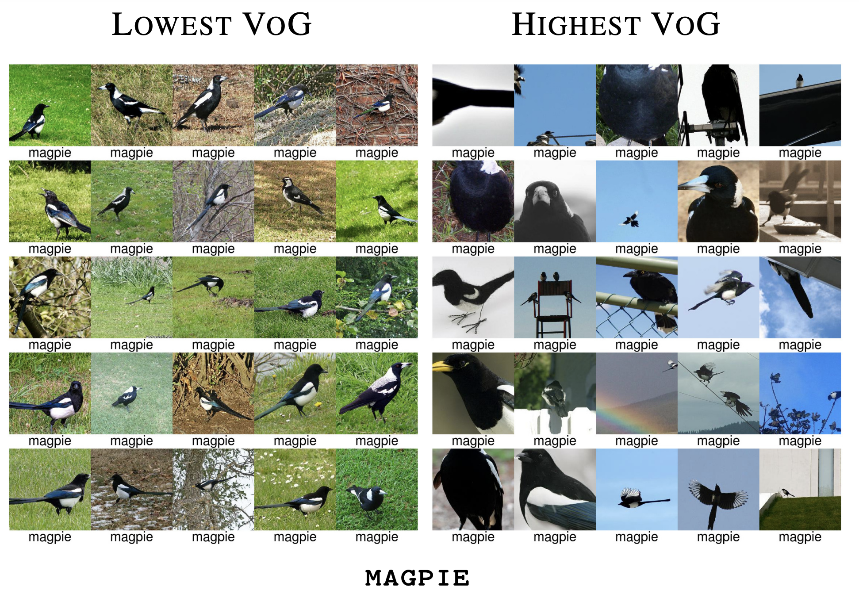
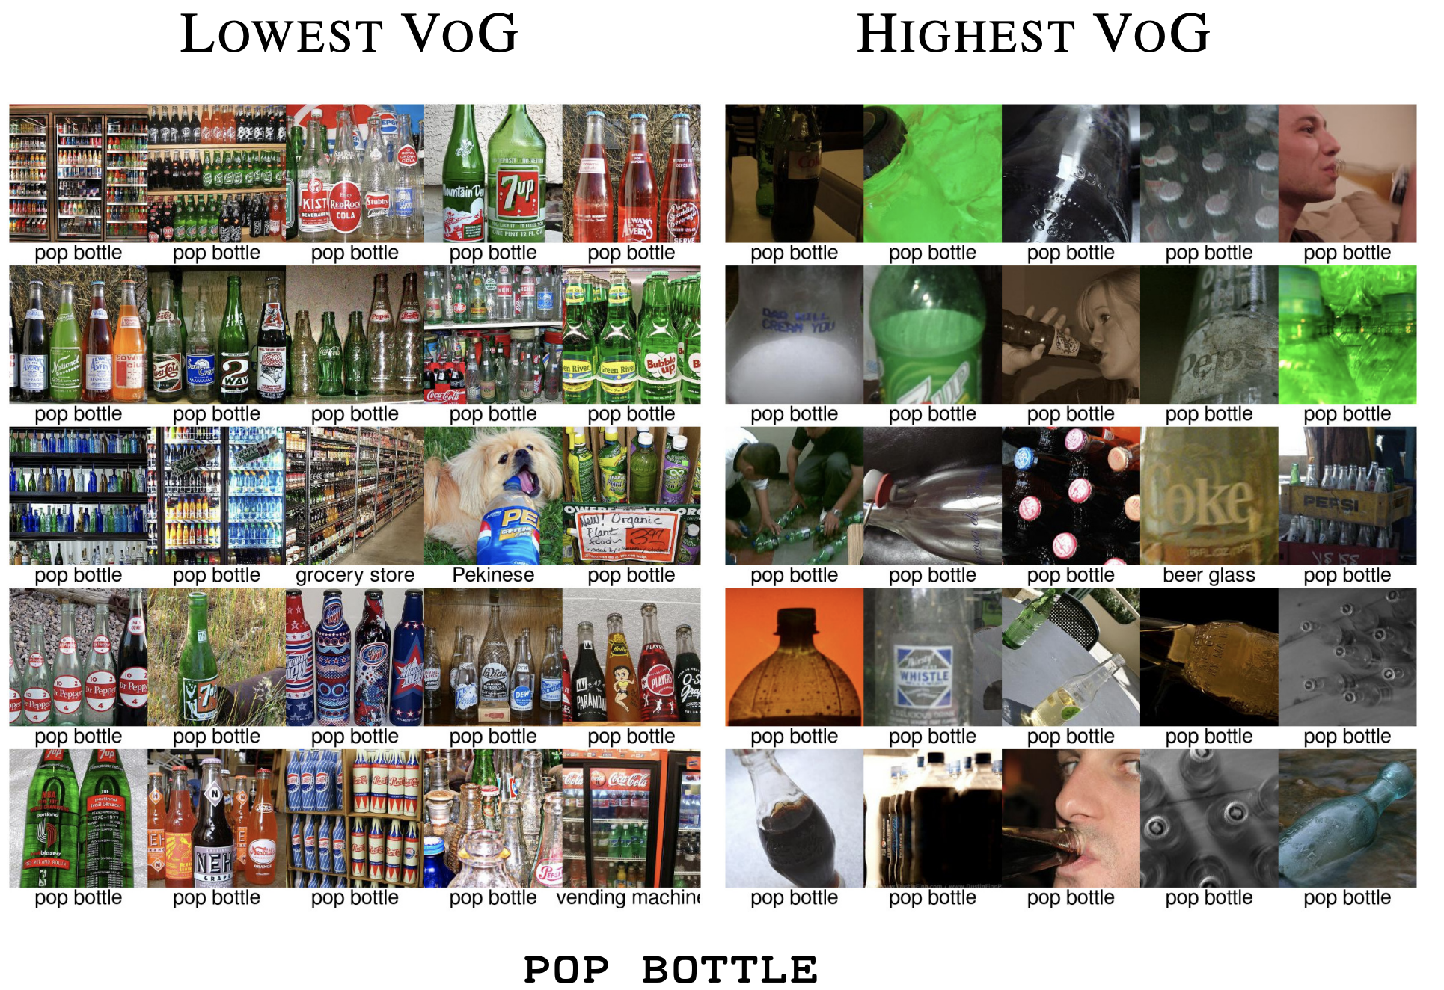
Task 2: Relative Ranking

Slide 10
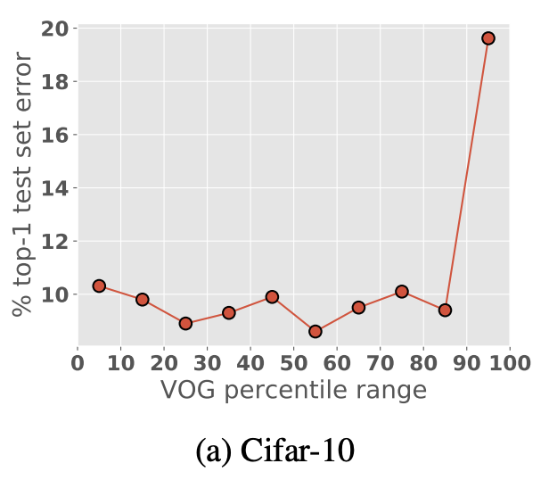
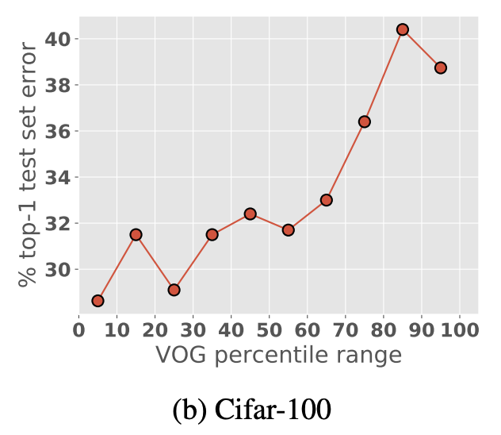
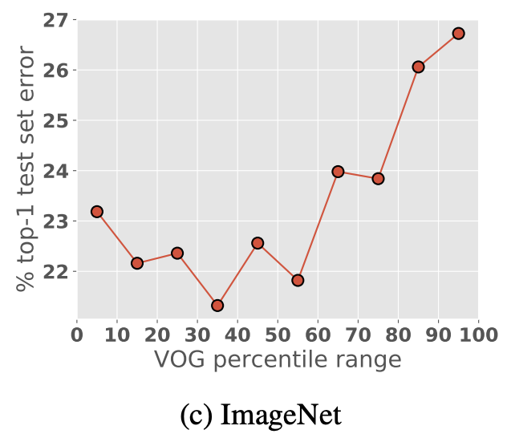
Task 3: Analyzing misclassification

Slide 11



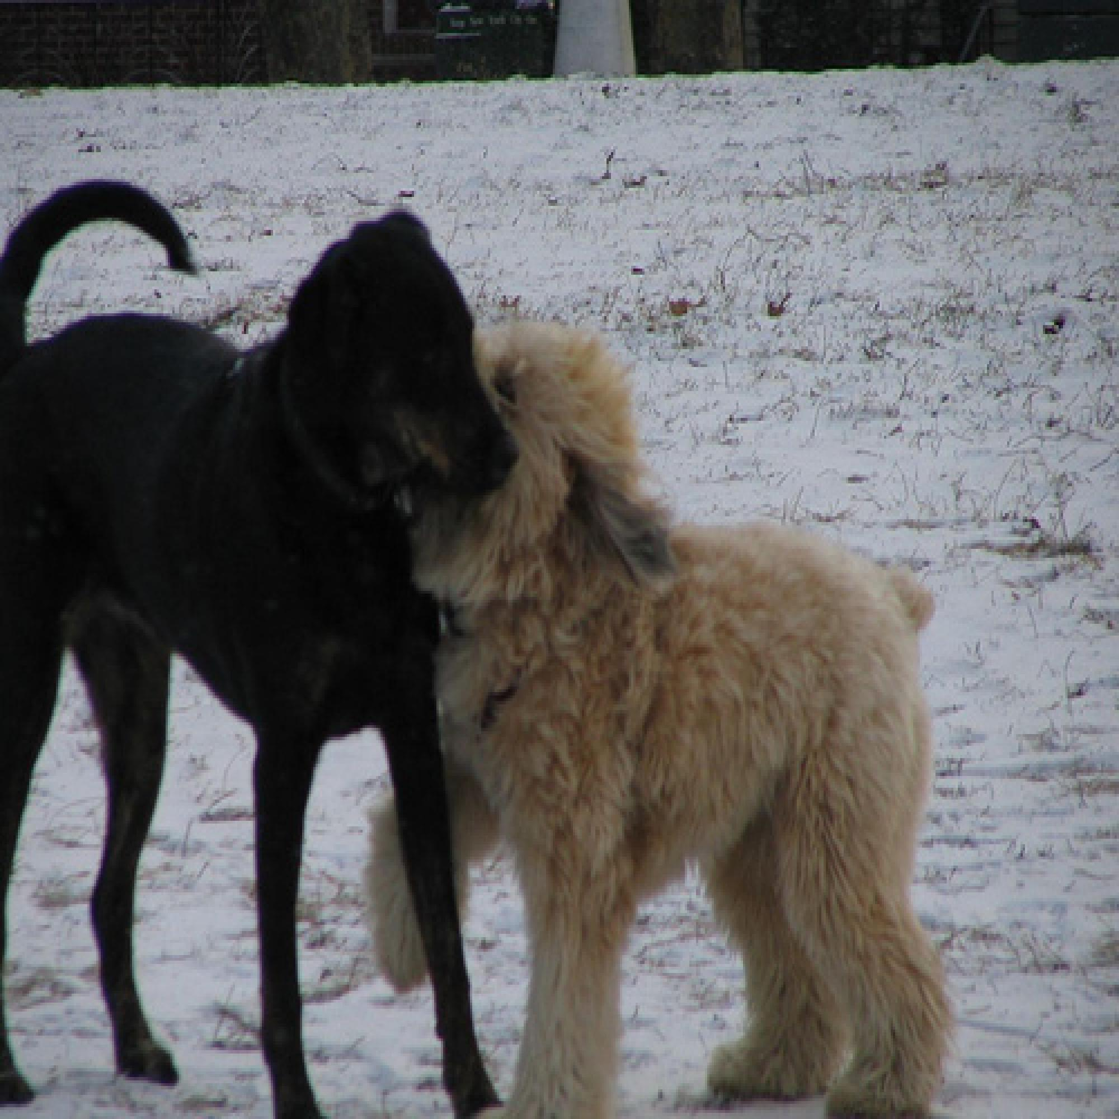
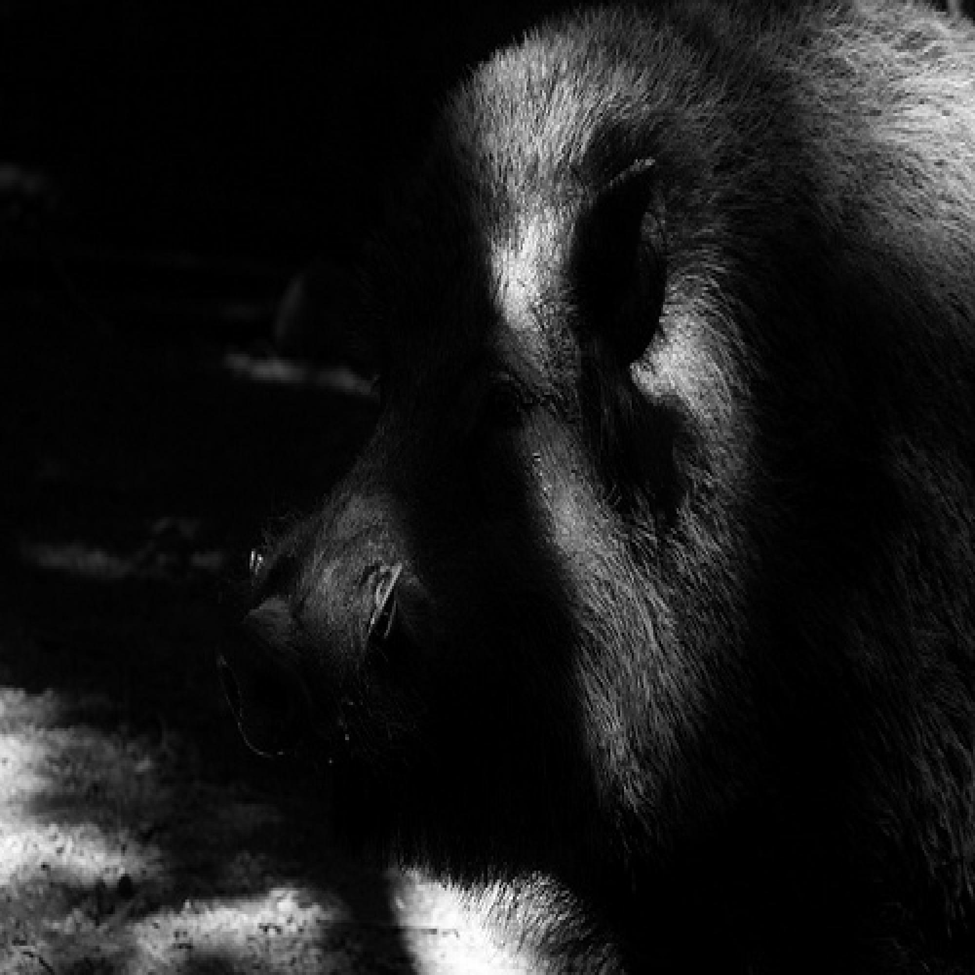

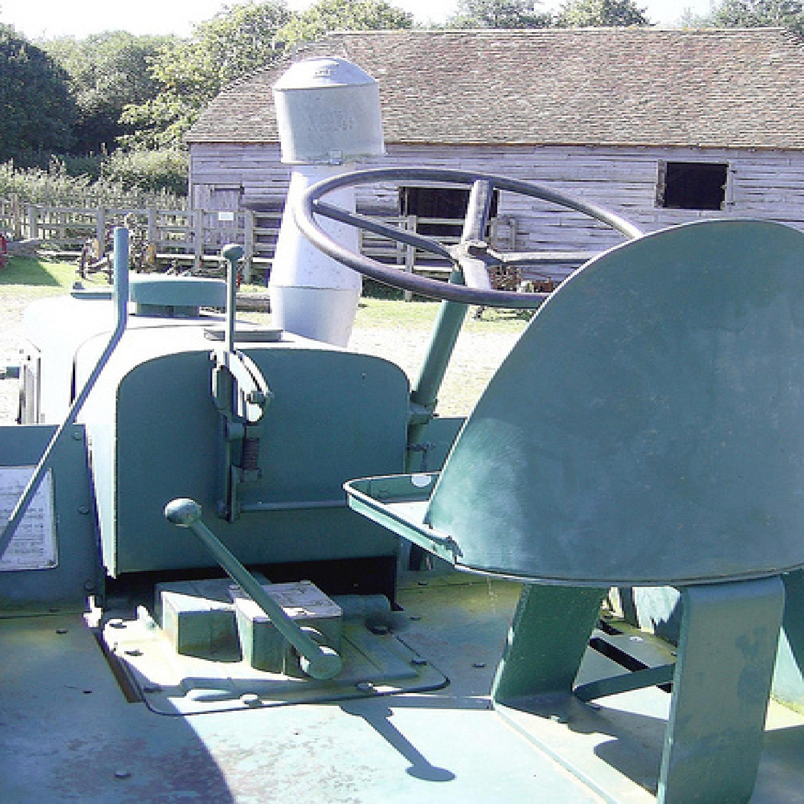



Task 4: Effective Unsupervised Auditing Tool
High VoG Score Images from Imagenet Validation Set
GT : horizontal bar
PL : parallel bars
GT : plate
PL : wok
GT : horse cart
PL : go-kart
GT : wheaten terrier
PL : tibetan terrier
GT : hog
PL : hog
GT : barbershop
PL : barbershop
GT : tractor
PL : barrow
GT : artichoke
PL : mixing bowl
GT : car mirror
PL : rubber eraser
GT : stove
PL : fire screen

Slide 12
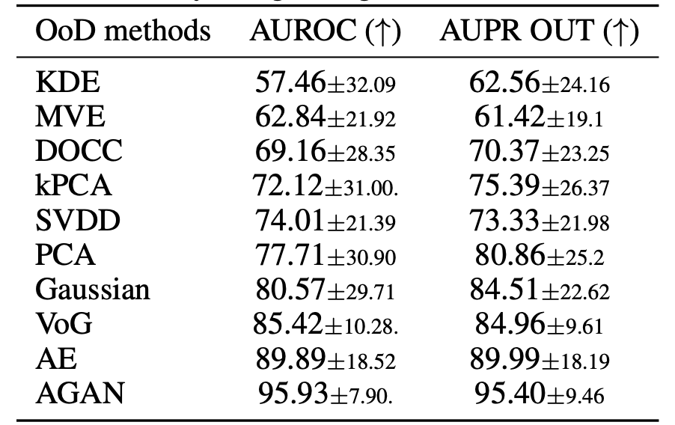
Task 5: Out-of-Distribution (OoD) Detection

Slide 13
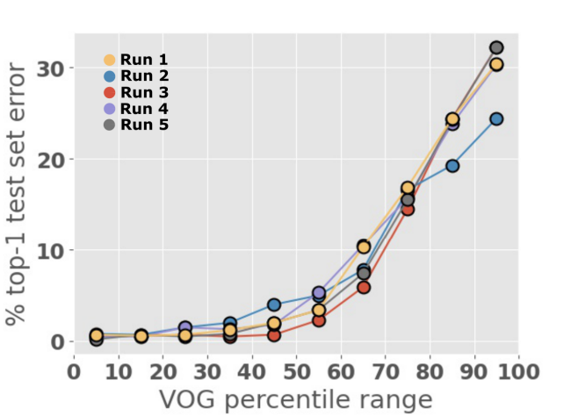
Stability of VoG Ranking

Slide 14
VoG Takeaways
Intuitive Proxy Metric
Efficient and Stable
Model and Task Agnostic
Open-source Code/VoG scores with Jupyter Notebook!
https://varianceofgradients.github.io/

Slide 15
Learning a Sparser Model

Slide 16
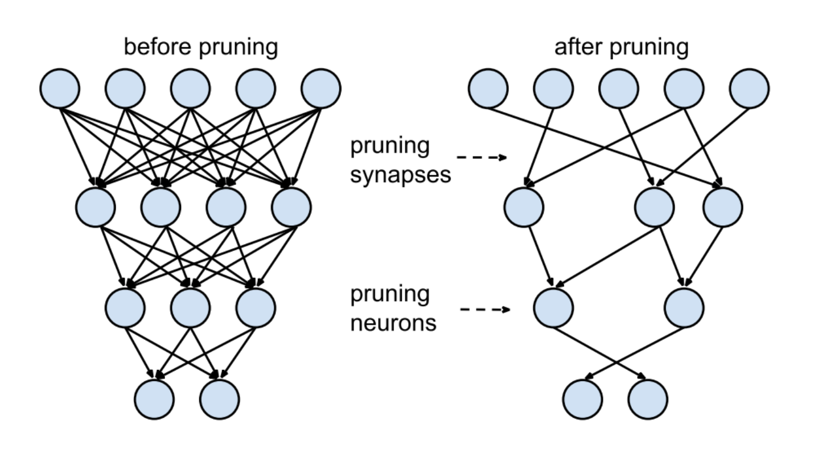
Pruning by explaining

Slide 17
Types of Pruning
Iterative Pruning
Weight Pruning
Neuron Pruning

Slide 18
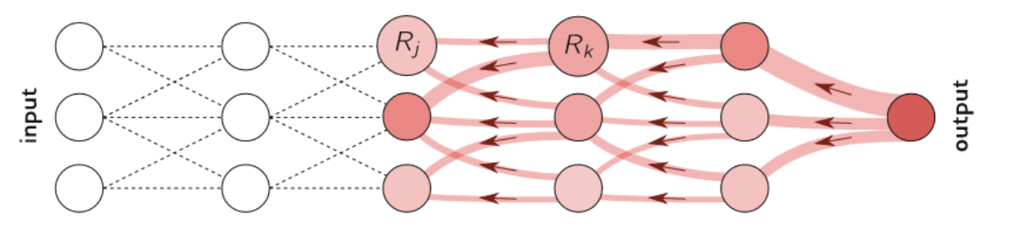
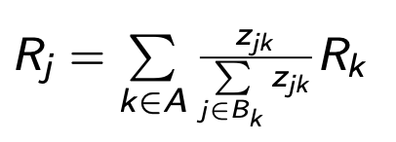
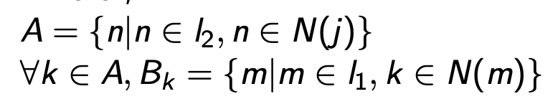
Layer-wise Relevance Propagation
Propagating relevance from neurons “k” at layer l2 onto neuron “j” of the lower layer l1 with the following rule

Slide 19
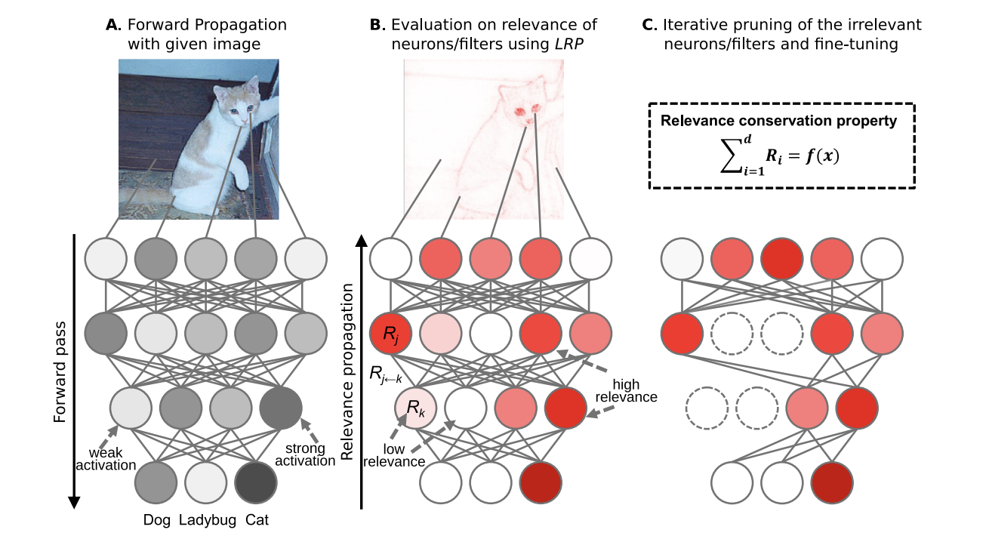
Pruning by Explaining
Yeoma et al. 2021

Slide 20
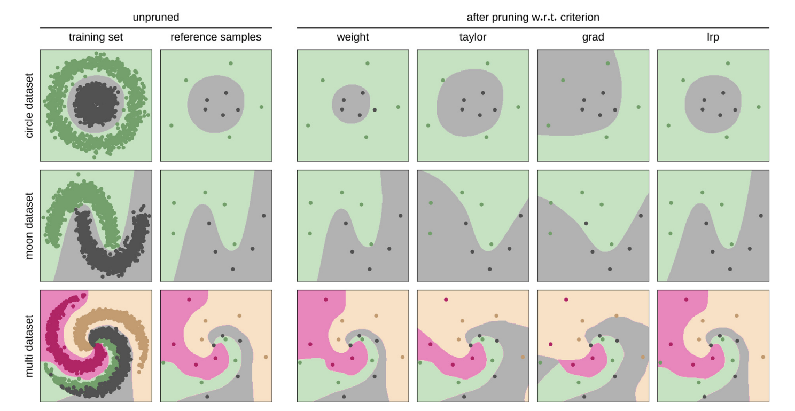
Qualitative comparison

Slide 21
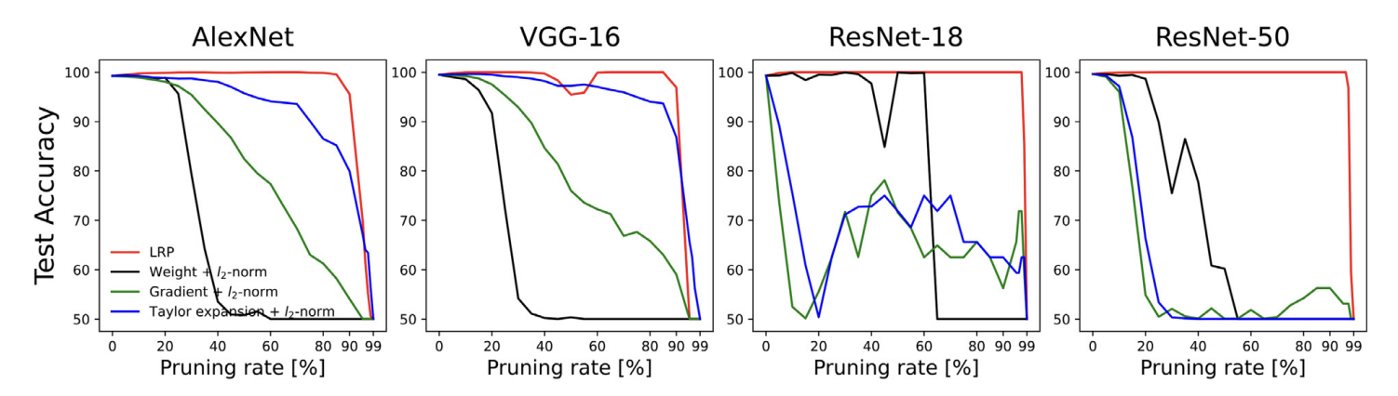
Quantitative results

Slide 22
Takeaways
Removing units according to low LRP scores means discarding all aspects in the model that do not contribute relevance to its decision making
LRP is scalable to network structures and its computational inexpensive
LRP criterion has shown favorable compression performance on a variety of datasets

Slide 23
Learning Better Explanations

Slide 24
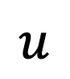

Graph Explanations
Node Attributes
Nodes
.
.
.
.
$$u$$
.
.
.
.
Edges
$$v$$
.
.
.
.
.
.
.
.

Slide 25
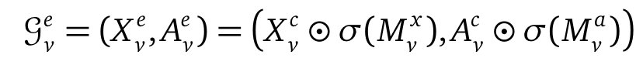
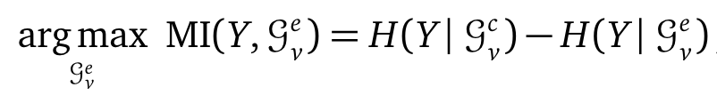
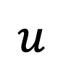

GNNExplainer
Node Attributes
Nodes
.
.
.
.
$$u$$
.
.
.
.
Edges
$$v$$
.
.
.
.
.
.
.
.
Ying et al. 2019

Slide 26
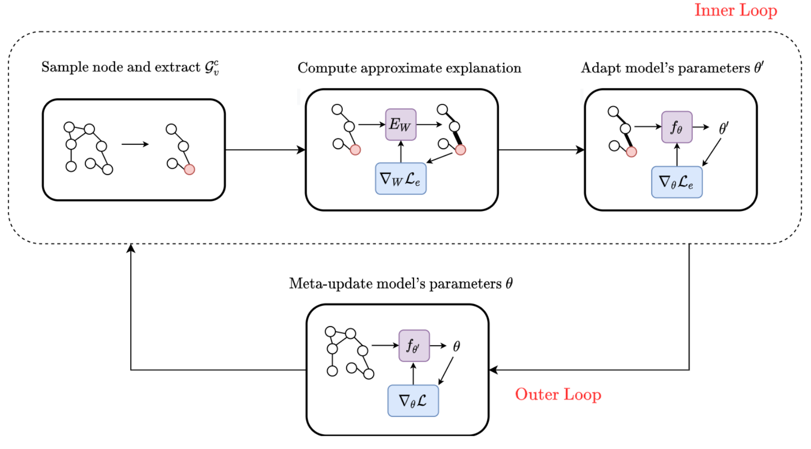
Meta-Learning Approach for Training Explainable GNNs

Slide 27
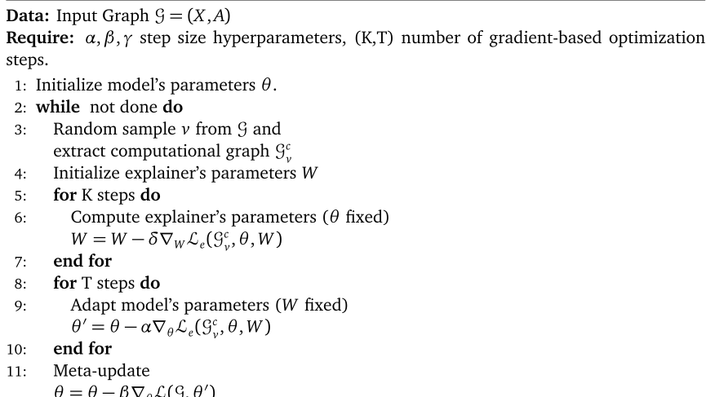
Meta-Learning Approach for Training Explainable GNNs

Slide 28
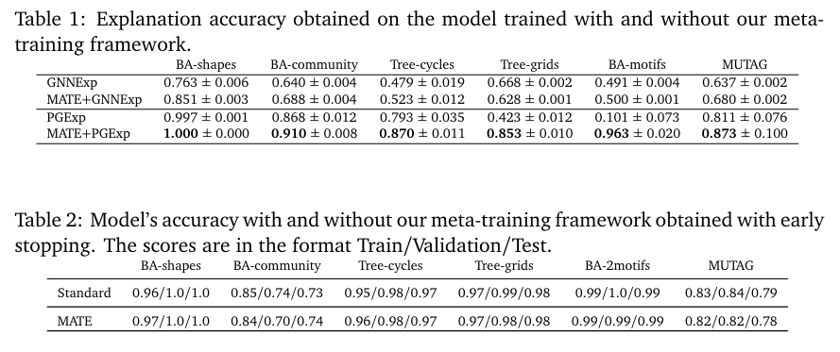
Results

Slide 29
Where to go next?
Human studies using practitioners and domain experts
Using in hoc explanations to improve model performance
Explaining multi-modal models
Understanding the differences between Adversaries and Explanations

Slide 30
Thank You!
Email: chiragagarwall12@gmail.com
Twitter: @_cagarwal
Trustworthy ML Initiative: https://www.trustworthyml.org/
Lots of resources and seminar series on topics related to explainability, fairness, adversarial robustness, differential privacy, causality etc.

